Slide 1


Slide 2


Slide 3


Slide 4
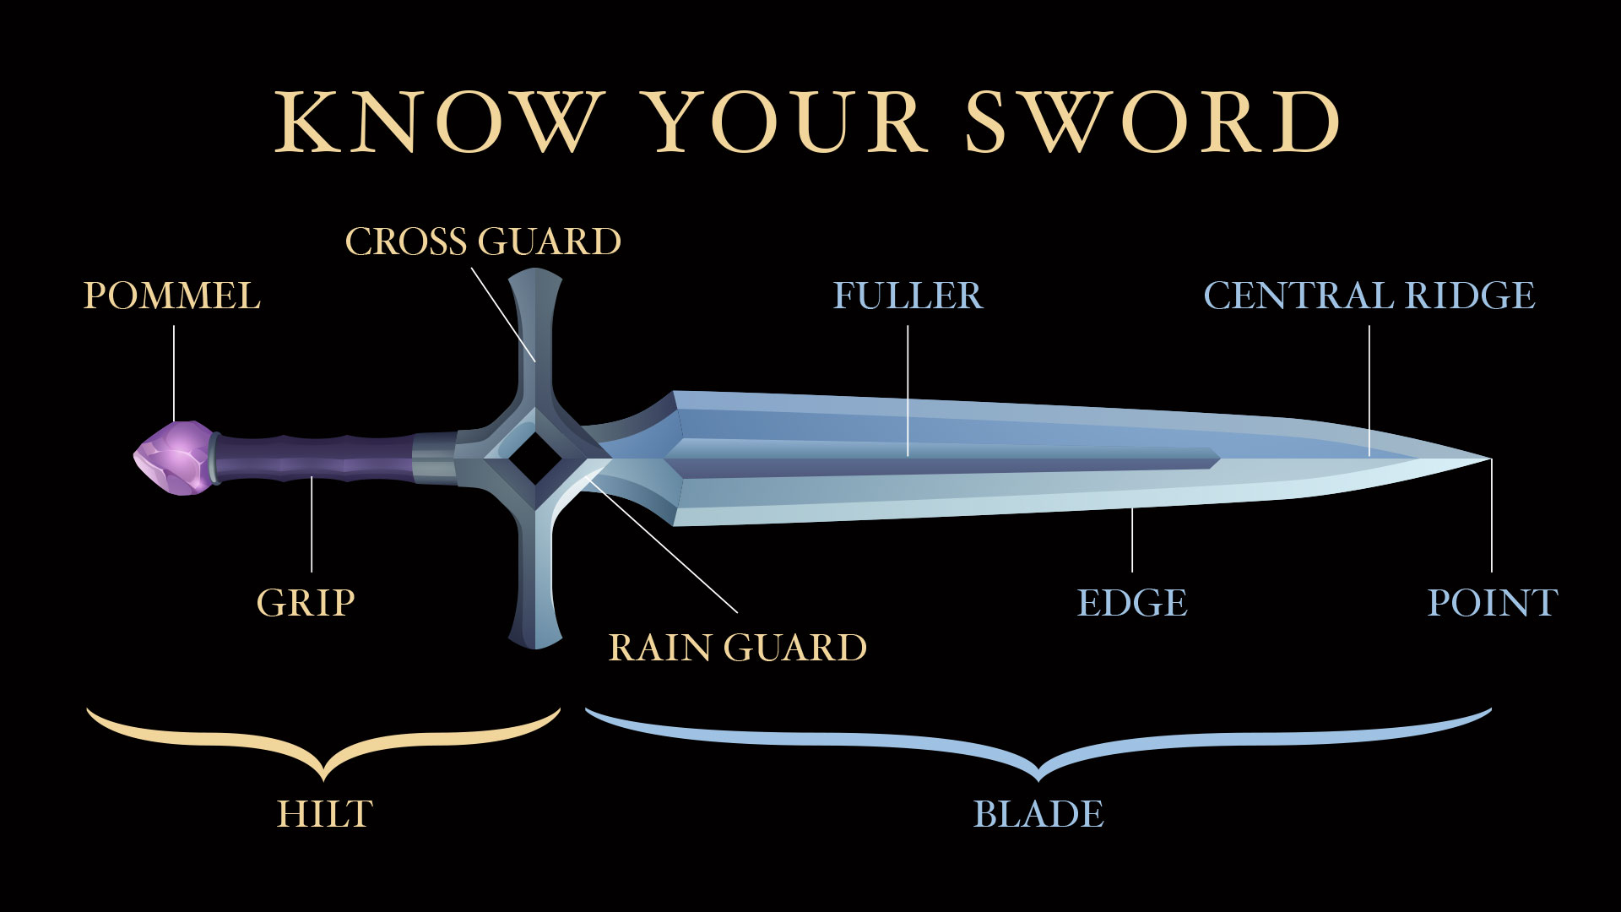

Slide 5


Slide 6


Slide 8
The additional slides below are
provided so the PowerPoint can be adapted to best fit your needs.

Slide 9


Slide 10


